Slide 1
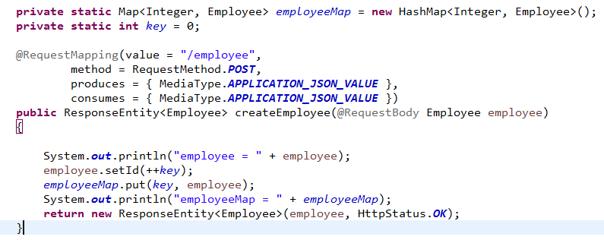
Store Employees Temporary

Slide 2
Validating HTTP POST Request Body
https://www.udemy.com/course/restful-web-services-with-spring-framework-a-quick-start/learn/lecture/12081634#overview

